Slide 1

SEMESTER I AI6101: APPLIED STATISTICS AND PROBABILITY
Dr. Rahul Sharma
Assistant Professor (Senior Scale)
Department of Artificial Intelligence and Machine Learning
Manipal University Jaipur
Email: sharma.rahul@jaipur.manipal.edu

Slide 2
Measure of central tendency
Measures of central tendency are statistical tools used to identify the centre or typical value in a data set.
The three main types are mean, median, and mode.
Mean is the average of all values.
Median is the middle value when data is arranged in order.
Mode is the value that appears most frequently.
These measures help summarize and compare data distributions in a simple way.

Slide 3
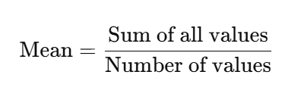
Measure of central tendency: mean
Mean (Average) is a measure of central tendency that represents the sum of all values divided by the number of values.
Formula:
Example: Consider the numbers: 10, 15, 20, 25, 30 Sum = 10 + 15 + 20 + 25 + 30 = 100 Number of values = 5 Mean = 100 ÷ 5 = 20
So, the mean of the given data is 20.

Slide 4
Measure of central tendency: median
Median is the middle value of a data set when the numbers are arranged in ascending or descending order. It divides the data into two equal halves.
Steps to find the Median:
Arrange the data in order.
If the number of values is odd, the median is the middle value.
If the number of values is even, the median is the average of the two middle values.

Slide 5
Measure of central tendency: median
Example (odd count): Data: 12, 15, 18, 22, 25 Median = 18 (middle value)
Example (even count): Data: 10, 20, 30, 40 Median = (20 + 30) ÷ 2 = 25
So, the median represents the central value of an ordered data set.

Slide 6
Measure of central tendency: mode
Mode is the value that appears most frequently in a data set. A set can have one mode (unimodal), more than one mode (bimodal or multimodal), or no mode at all.
Steps to find the Mode:
Count the frequency of each value.
The value with the highest frequency is the mode.

Slide 7
Measure of central tendency: mode
Example 1 (one mode): Data: 4, 7, 7, 9, 10 Mode = 7 (occurs twice)
Example 2 (two modes): Data: 3, 3, 6, 6, 9 Modes = 3 and 6 (both occur twice)
If no number repeats, the data set has no mode. Mode is useful for categorical data or to know the most common value.

Slide 8
Measures of dispersion- Range
Range is a simple measure of dispersion that shows the spread or difference between the highest and lowest values in a data set.
Formula:
Range=Maximum value−Minimum value
Example: Data: 8, 12, 15, 20, 25 Maximum = 25, Minimum = 8 Range = 25 − 8 = 17
The range indicates how widely the values in a set are spread out. However, it is sensitive to extreme values (outliers).

Slide 9
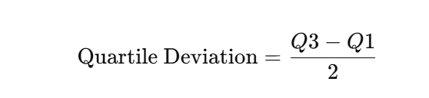
Quartile Deviation
Quartile Deviation, also known as Semi-Interquartile Range, measures the spread of the middle 50% of a data set. It is based on the first quartile (Q1) and third quartile (Q3).
Formula:
Q1 is the 25th percentile (lower quartile)
Q3 is the 75th percentile (upper quartile)

Slide 10

Quartile Deviation
Example: If Q1 = 20 and Q3 = 40
Quartile deviation is less affected by extreme values and is useful for skewed distributions.

Slide 11
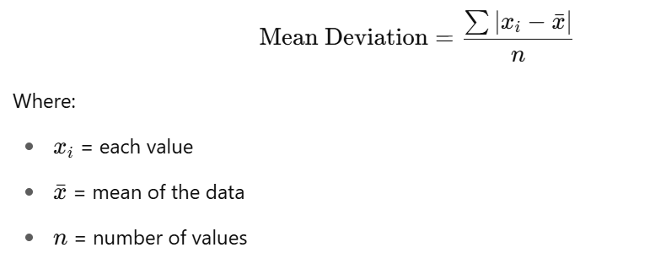
Mean Deviation
Mean Deviation is a measure of dispersion that shows the average of the absolute differences between each data value and the mean or median of the data set.
Formula:

Slide 12
Mean Deviation
Example: Data: 4, 6, 8 Mean = (4 + 6 + 8)/3 = 6 Deviations: |4−6| = 2, |6−6| = 0, |8−6| = 2 Mean Deviation = (2 + 0 + 2)/3 = 1.33
Mean deviation gives a better sense of average variability but ignores the direction (positive or negative) of deviations.

Slide 13
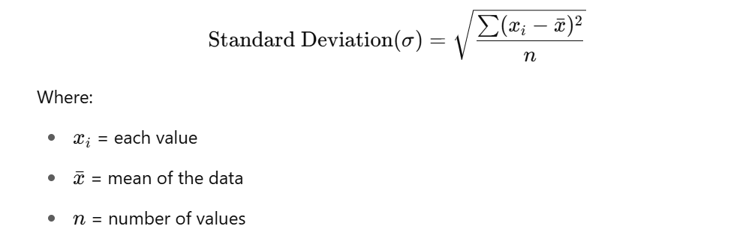
Standard Deviation
Standard Deviation is a widely used measure of dispersion that shows how much the values in a data set deviate from the mean on average.
Formula:

Slide 14
Standard Deviation
Example: Data: 2, 4, 6 Mean = (2 + 4 + 6)/3 = 4 Deviations squared: (2−4)² = 4, (4−4)² = 0, (6−4)² = 4 Variance = (4 + 0 + 4)/3 = 2.67 Standard Deviation = √2.67 ≈ 1.63
Standard deviation gives a clear picture of how data is spread around the mean and is widely used in statistical analysis.

Slide 15
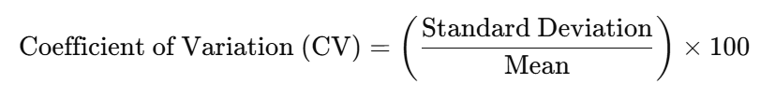
Coefficient of variance
Coefficient of Variation (CV) is a measure of relative dispersion, showing the ratio of the standard deviation to the mean. It helps compare the variability of two or more data sets with different units or means.
Formula:

Slide 16
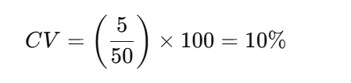
Coefficient of variance
Example: If Mean = 50 and Standard Deviation = 5
A lower CV indicates less variability, and a higher CV indicates more variability relative to the mean. CV is especially useful for comparing consistency between data sets.

Slide 17
Skewness,
Skewness:
It measures the asymmetry of a distribution.
Positive Skew (Right-skewed): Tail is longer on the right; mean > median
Negative Skew (Left-skewed): Tail is longer on the left; mean < median
Zero Skewness: Data is symmetric (mean = median)
Example: Income data often shows positive skewness.

Slide 18
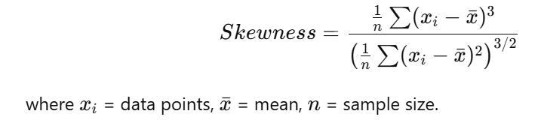
Skewness
Meaning: Skewness measures the asymmetry (tilt) of a probability distribution or dataset.
Interpretation:
Skewness = 0 → The data is perfectly symmetric (like a normal distribution).
Positive Skew (Right-skewed) → The right tail is longer; most values are on the left. Example: income distribution.
Negative Skew (Left-skewed) → The left tail is longer; most values are on the right. Example: age at death (in certain populations).
Formula (sample skewness):

Slide 19
Kurtosis
Kurtosis:
It measures the "tailedness" or peakedness of a distribution.
Leptokurtic (High Kurtosis): Sharp peak, heavy tails
Platykurtic (Low Kurtosis): Flat peak, light tails
Mesokurtic (Normal Kurtosis): Bell-shaped, like a normal distribution
Example: Stock return data may have high kurtosis due to extreme values.

Slide 20
Kurtosis
Kurtosis:
It measures the "tailedness" or peakedness of a distribution.
Leptokurtic (High Kurtosis): Sharp peak, heavy tails
Platykurtic (Low Kurtosis): Flat peak, light tails
Mesokurtic (Normal Kurtosis): Bell-shaped, like a normal distribution
Example: Stock return data may have high kurtosis due to extreme values.

Slide 21
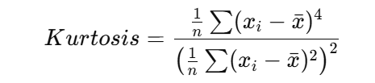
Kurtosis
Meaning: Kurtosis measures the “tailedness” or peakedness of a distribution compared to the normal distribution.
Interpretation:
Kurtosis = 3 (Mesokurtic) → Same as normal distribution.
Kurtosis > 3 (Leptokurtic) → Heavier tails, sharper peak (more outliers likely).
Kurtosis < 3 (Platykurtic) → Flatter peak, thinner tails (fewer outliers).
Formula (sample kurtosis):
Often we report Excess Kurtosis = Kurtosis – 3 so that normal distribution has 0.

Slide 22
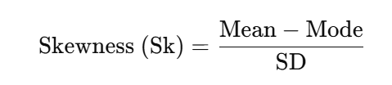
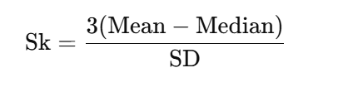
Karl Pearson’s Coefficient of Skewness
It measures the degree and direction of asymmetry of a frequency distribution.
Formula
If Mode is not known, then Pearson suggested an approximation:

Slide 23
Karl Pearson’s Coefficient of Skewness
Interpretation
Sk = 0 → Symmetrical distribution (like Normal distribution).
Sk > 0 → Positively skewed (long tail to the right, mean > median > mode).
Sk < 0 → Negatively skewed (long tail to the left, mean < median < mode).
Step-by-Step Calculation (General Approach)
Find the Mean of the distribution.
Find the Median or Mode (depending on which is available).
Find the Standard Deviation (SD).
Apply the formula.
Interpret the result (positive, negative, or zero skewness).
Karl Pearson’s coefficient of skewness uses mean, median/mode, and standard deviation to measure asymmetry in data.

Slide 24
Practice Numerical
1. Mean
The marks obtained by 10 students in a test are: 25, 28, 30, 32, 35, 40, 42, 45, 50, 55. Find the mean marks.
2. Median
The following are the ages of 11 players of a cricket team: 18, 20, 21, 22, 23, 24, 25, 26, 27, 28, 30. Find the median age.

Slide 25
Practice Numerical
3. Mode
The marks obtained by students are: 10, 15, 20, 20, 25, 25, 25, 30, 35, 40. Find the mode.
4. Range
The daily wages (in ₹) of 7 workers are: 120, 150, 180, 200, 220, 250, 300. Find the range.

Slide 26
Practice Numerical
5. Quartile Deviation (Q.D.)
The incomes of 9 families (in ₹ ’000) are: 12, 15, 18, 20, 22, 24, 28, 30, 35. Find the Quartile Deviation.
6. Mean Deviation (M.D.)
The marks obtained by students are: 5, 10, 15, 20, 25.
Find the Mean Deviation about the Mean.

Slide 27
Practice Numerical
7. Standard Deviation (S.D.)
The marks obtained in statistics by 5 students are: 12, 15, 20, 22, 25. Find the Standard Deviation.
8. Coefficient of Variation (C.V.)
The monthly incomes (in ₹) of 5 persons are: 2000, 2200, 2500, 2800, 3000. Find the Coefficient of Variation.

Slide 28
Practice Numerical
9. Skewness (Karl Pearson’s Method)
The mean = 60, median = 55, and standard deviation = 10. Find the coefficient of skewness.
10. Kurtosis (based on β₂)
For a distribution, the fourth central moment = 500, and the square of the second central moment = 100² = 10,000. Find the coefficient of kurtosis (β₂ = μ₄ / μ₂²).

Slide 29
Practice Numerical Answers
1. Mean Sum = 382 → Mean = 382/10 = 38.2
2. Median Ordered (11 values), middle = 6th value = 24
3. Mode Most frequent = 25
4. Range Max − Min = 300 − 120 = 180

Slide 30
Practice Numerical Answers
5. Quartile Deviation (Q.D.) Median = 22; Lower half: 12,15,18,20 ⇒ Q1 = (15+18)/2 = 16.5 Upper half: 24,28,30,35 ⇒ Q3 = (28+30)/2 = 29 Q.D. = (Q3 − Q1)/2 = (29 − 16.5)/2 = 6.25 (in ₹ ’000)
6. Mean Deviation about Mean Mean = 15; |deviations| = 10,5,0,5,10 → sum = 30 M.D. = 30/5 = 6

Slide 31
Practice Numerical Answers
7. Standard Deviation (population) Mean = 18.8; variance = 22.16 → SD = √22.16 = 4.71 (approx)
8. Coefficient of Variation (C.V.) (population) Mean = 2500; SD ≈ 368.78 C.V. = (SD/Mean)×100% ≈ (368.78/2500)×100% = 14.75%
9. Skewness (Karl Pearson, using mean–median) Sk = 3(Mean − Median)/SD = 3(60 − 55)/10 = 1.5 (positively skewed)
10. Kurtosis (β₂) β₂ = μ₄/μ₂² = 500/10,000 = 0.05 (very platykurtic)

Slide 32
Questions
Define mean, median, and mode with simple examples.
Find the mean of: 10, 20, 30, 40, 50.
Find the range of daily wages: 120, 150, 180, 200, 250.
State the difference between Skewness and Kurtosis.
Define Coefficient of Variation. Why is it used?
The ages of 9 students are: 12, 13, 14, 15, 15, 16, 17, 18, 20. Find the median.
Find the mode of: 5, 10, 10, 15, 20, 20, 20, 25, 30.
The incomes of 5 families (in ₹’000) are: 20, 22, 25, 28, 30. Find the Coefficient of Variation.
Define Quartile Deviation and illustrate with a numerical example.
Explain positive and negative skewness with a diagram.

Slide 33
Questions
The marks of students are: 12, 15, 20, 22, 25. Find the Mean Deviation about Mean.
Calculate the Standard Deviation of: 2, 4, 6, 8, 10.
For a distribution, Mean = 50, Median = 45, S.D. = 10. Find Karl Pearson’s coefficient of Skewness.
Write short notes on: a) Range and its limitations b) Importance of Standard Deviation

Slide 34
Questions
The marks obtained by 10 students are: 25, 28, 30, 32, 35, 40, 42, 45, 50, 55. Find the Mean, Median and Mode.
The daily wages of 7 workers are: 120, 150, 180, 200, 220, 250, 300. Calculate Range, Quartile Deviation, and Standard Deviation.
ANS := Final Results
Range = 180, Quartile Deviation = 50, Standard Deviation ≈ 56.26
The mean of a distribution is 60, Median = 55, and S.D. = 10. Find Skewness and comment on the nature of distribution.
For a distribution, the second central moment (μ₂) = 25, and the fourth central moment (μ₄) = 450. Find the Kurtosis and state whether the distribution is leptokurtic, mesokurtic, or platykurtic. Ans: Kurtosis = 0.72

